Slide 1

HOSPITAL MANAGEMENT SYSTEM
SRM INSTITUTE OF SCIENCE AND TECHNOLOGY
FACULTY OF ENGINEERING AND TECHNOLOGY
DEPARTMENT OF NETWORKING AND COMMUNICATIONS
18CSS108- MINI PROJECT
YESHWANTH SURISETTY(RA2111047010029)
Branch : BTECH Artificial Intelligence
Section : A
Lab Instructor name : HARIHARAN B

Slide 2
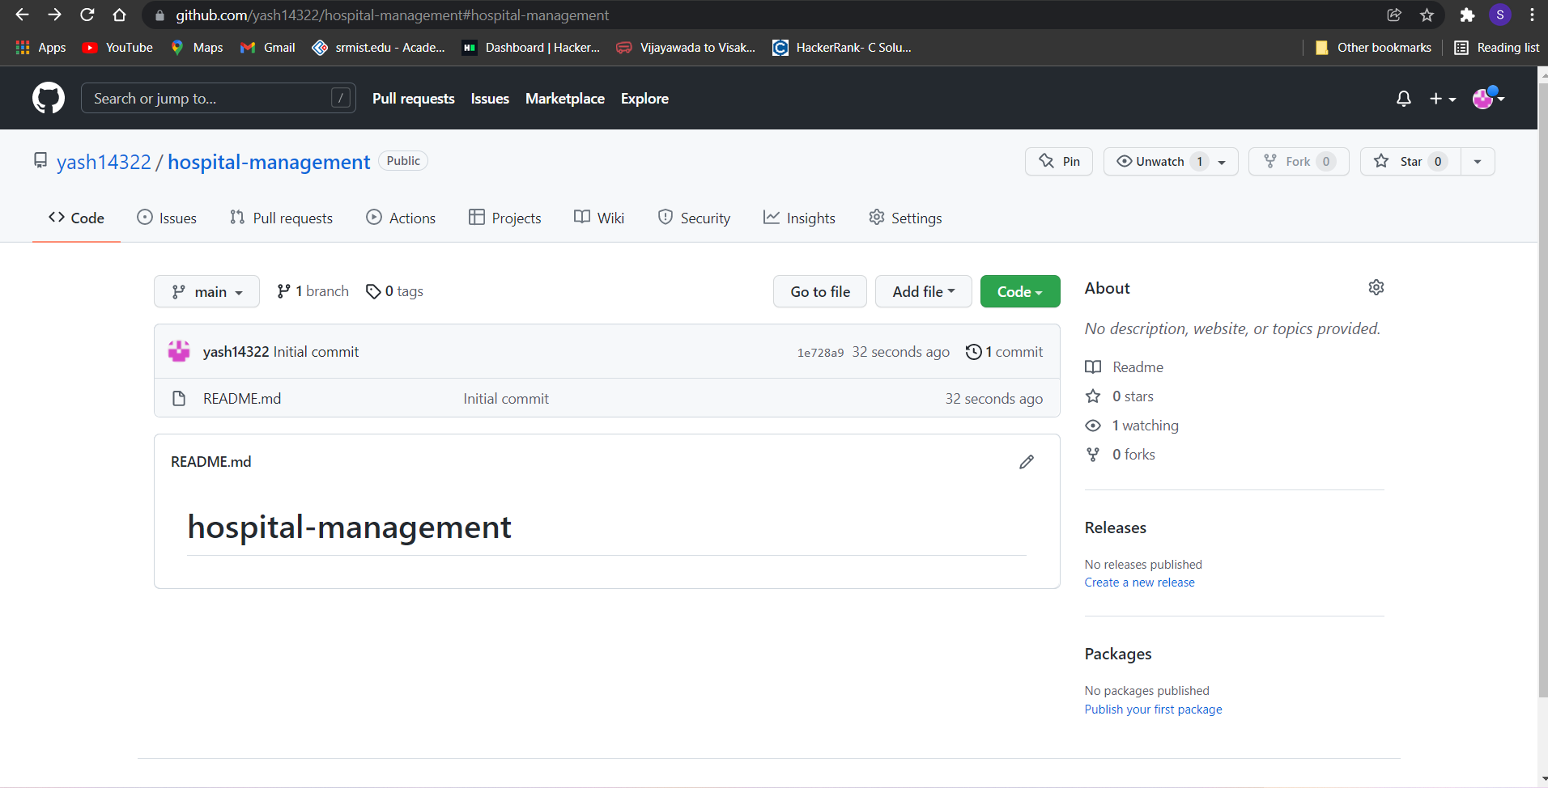

Slide 3
Table of contents
Introduction – [Project Title & Reason for choosing]
Objectives
Algorithm
Flowchart
Results and Explanation
References

Slide 4
Introduction

Slide 5
Topic
Hospital Management System

Slide 6
Reason For Choosing
Considering a multispecialty hospital, many people enter and exit the hospital in a day and maintaining their records safely is tedious. To reduce this type of burdens and to manage the financial, hospital administration and clinical aspects, Hospital management system came into existence. So, our team decided to come in this topic to create hospital management system that help the hospital members to manage all the system.

Slide 7
Objectives
HMS was introduced to solve the complications coming from managing all the paper works of every patient associated with the various departments of hospitalization with confidentiality. HMS provides the ability to manage all the paperwork in one place, reducing the work of staff in arranging and analyzing the paperwork of the patients. HMS does many works like:
Helps to keep the record of all the patients & staff.
Helps to keeps the records of all the appointments.
It easily modify any patient & staff details .
It keeps the record of every bill payment.
It easily display the list of patients & staffs.
Every hospital has different needs, analyze what is best for your requirement and install the apt HMS system.

Slide 8
Algorithm

Slide 9
Algorithm
For New Entry
Step – 1 : Start
Step – 2 : Display heading
Step – 3 : Store values in structure array
Step – 4 : For i =0 to number of variable stored in structure array
Display stored structure array
Step – 5 : if more new entry
goto step 3
else
goto step 6
Step – 6 : End

Slide 10
Algorithm
For Modify Entry
Step – 1 : Start
Step – 2 : Display heading
Step – 3 : Enter common structure array variable value
Step – 4 : Display all the details enter by that variable in the structure array
Step – 5 : Choosing the structure variable for modify in the structure array
Step – 6 : Entering new details
Step – 7 : Display the structure array after modifying
Step – 8 : if more modifying the details
goto step – 3
else
goto step – 9
Step – 9 : End

Slide 11
Algorithm
For Displaying Entry
Step – 1 : Start
Step – 2 : Display heading
Step – 3 : Display all the entry stored in the structure array
Step – 4 : End

Slide 12
Algorithm
For Searching Entry
Step – 1 : Start
Step – 2 : Display Heading
Step – 3 : Enter common structure array variable value
Step – 4 : if structure array variable = entered value
Display details of that variable
else
Display Not Found
Step – 5 : if more search details
goto step – 3
else
goto step – 6
Step – 6 : End

Slide 13
Algorithm
For Multiplication of Numbers
Step – 1 : Start
Step – 2 : Display heading
Step – 3 : Display structure array
Step – 4 : Enter common structure array variable value
Step – 5 : if structure array variable = entered value
Step – 5.1 : Display details of that variable
Step – 5.2 : Sum = Quantity * Price
else
Display Not Found
Step – 6 : if more required
goto step – 4
else
goto step – 7
Step – 7 : End

Slide 14
Algorithm
For Appointment Application
Step – 1 : Start
Step – 2 : Display heading
Step – 3 : Entry of details
Step – 4 : Display the appointment details
Step – 5 : if more appointment
goto step – 3
else
goto step – 6
Step – 6 : End

Slide 15
Algorithm
Complete Mini Project
Step – 1 : Start
Step – 2 : Display main menu
Step – 3 :
Step – 3.1 : if press 1
Open patient system
if press 1
Open new entry details system
if press 2
Open modify details system
if press 3
Open display details system
if press 4
Open search details system
if press 5
goto step 2

Slide 16
Algorithm
Step – 3.2 : if press 2
Open staff system
if press 1
Open new entry details system
if press 2
Open modify details system
if press 3
Open display details system
if press 4
Open search details system
if press 5
goto step 2
Step – 3.3 : if press 3
Open inventory system

Slide 17
Algorithm
Step – 3.4 : if press 4
Open mortuary system
if press 1
Open new entry details system
else if press 2
Open display details system
else if press 3
Open search details system
else
goto step 2
Step – 3.5 : if press 5
Open appointment application system
Step – 3.6 : if press 6
goto step 4
Step – 4 : End

Slide 18
Flowchart

Slide 19
Flowchart
For New Entry
Start
Enter the value in structure array
Display Entered values
Yes
For more entry
No
Stop

Slide 20
Flowchart
For Modify Entry
Start
Display entry before modify
Select the variable for modify
Modify the variable selected
Yes
For more modify
Display entry after modify
No
Stop

Slide 21
Flowchart
For Displaying Entry
Start
Display entire list
Stop

Slide 22
Flowchart
For Searching Entry
Start
Enter the specific variable from structured array
Display entire details
To another search
Yes
No
Stop

Slide 23
Flowchart
For Multiplication of Numbers
Start
Display entire list
Display Price
Enter quantity
structure array variable = entered value
Enter the specific variable from structured array
Sum = Price * Quantity
To another search
No
Display variable not found
Stop
Yes

Slide 24
Flowchart
For Appointment Application
Start
Enter details
Display appointment details
Yes
For another appointment
No
Stop

Slide 25
Flowchart
Complete Mini Project
Main
Menu
Patient System
Staff System
Inventory
Mortuary System
Doctor Appointment Application
End
New entry
New entry
New entry
Modify entry
Modify entry
Modify entry
List entry
List entry
List entry
Exit
Search entry
Search entry
Search entry
Main

Slide 26
Result & Explanation

Slide 27
Result & Explanation
Title of a Mini Project

Slide 28

Result & Explanation
Color used is E4
Background – E (Light Yellow)
Text – 4 (Red)

Slide 29
Result & Explanation
Main Menu

Slide 30
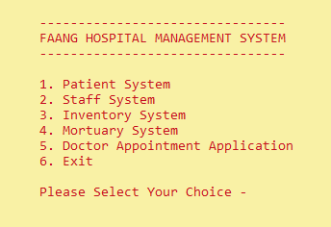
Result & Explanation
Menu main is basically divided into 6 parts by using switch case :-
Patient system
Staff system
Inventory System
Mortuary System
Doctor Appointment Application
Exit
By select the serial number you will be on that page

Slide 31
Result & Explanation
Patient System

Slide 32
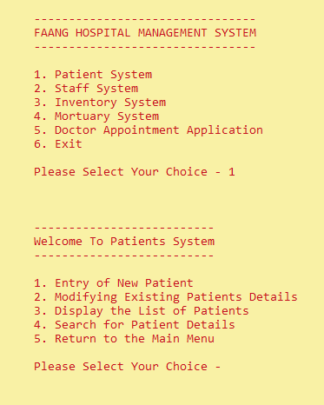
Result & Explanation
By selecting 1,
system will open patient system
Patient system is basically divided into 5 parts by using switch case :-
New Entry
Modify Entry
List Entry
Search Entry
Return to main menu
By select the serial number you will be on that page

Slide 33
Result & Explanation
New Entry in Patient System

Slide 34
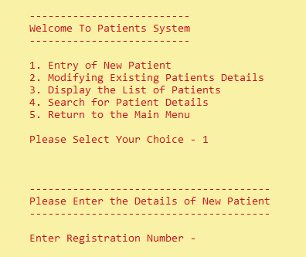
Result & Explanation
By selecting 1,
system will open new entry system for patient

Slide 35
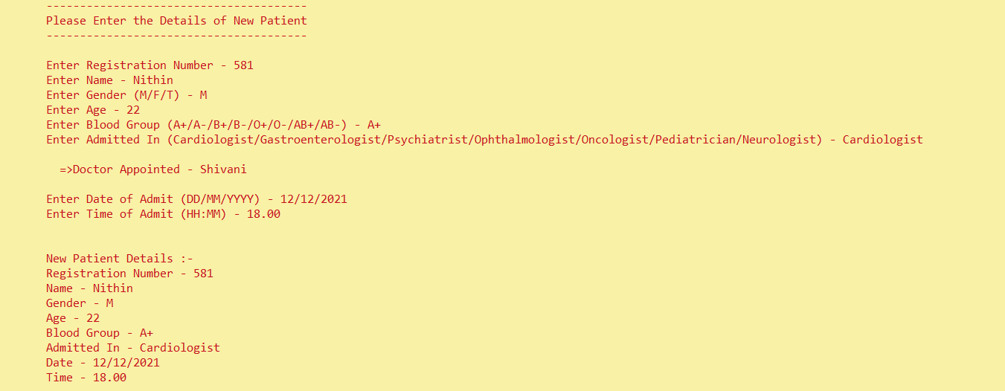
Result & Explanation
Now, one by one you must enter all the details of the patient
Doctor will be assigning you directly according to the specialization

Slide 36
Result & Explanation
Once you entered all the details, system will show all the details entered

Slide 37
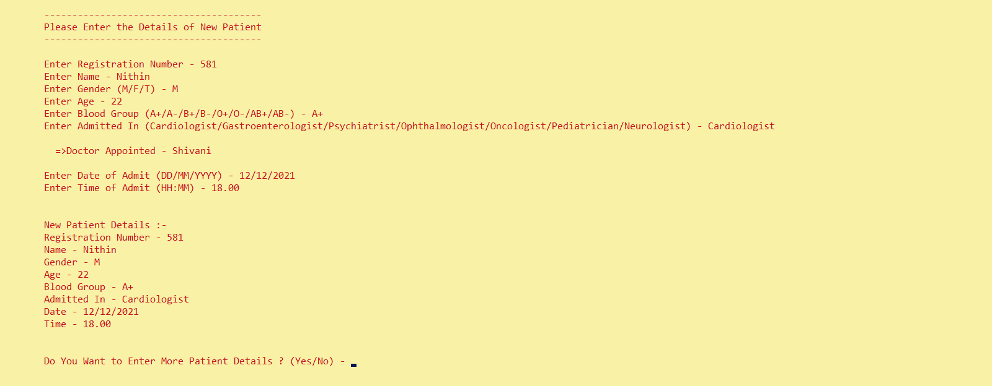
Result & Explanation
After all this system will ask whether you want to enter more new patient details

Slide 38
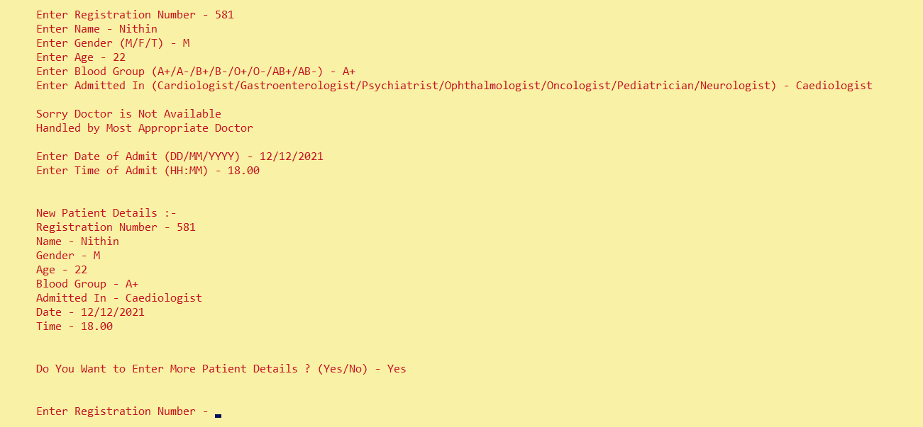
Result & Explanation
If you enter yes, it will again show you to enter details of new patient

Slide 39
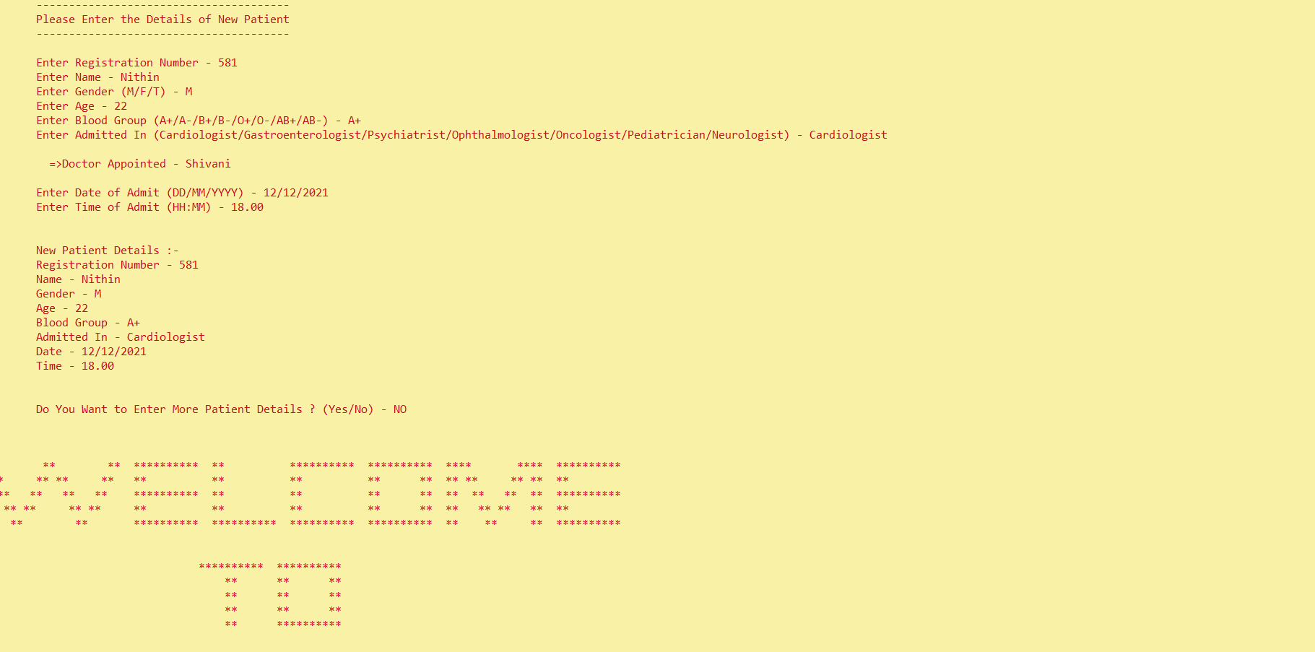
Result & Explanation
If you enter no, then it will go to main menu

Slide 40
Result & Explanation
Modify Entry in Patient System

Slide 41
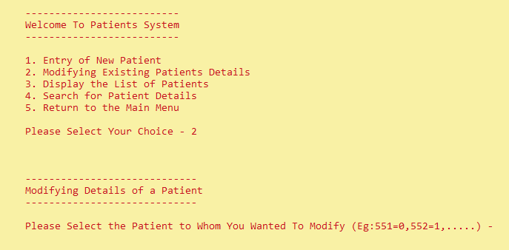
Result & Explanation
By selecting 2,
system will open modify entry system for patient

Slide 42
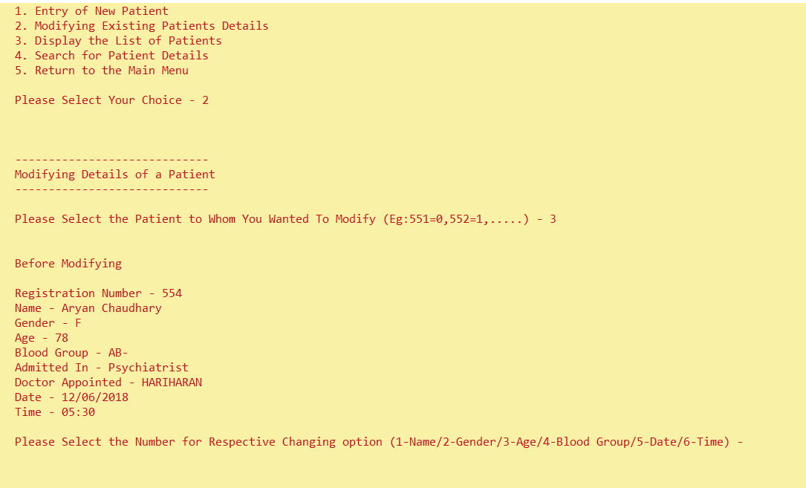
Result & Explanation
When you enter serial number of respective registration number it will automatically display all the details of that patient

Slide 43
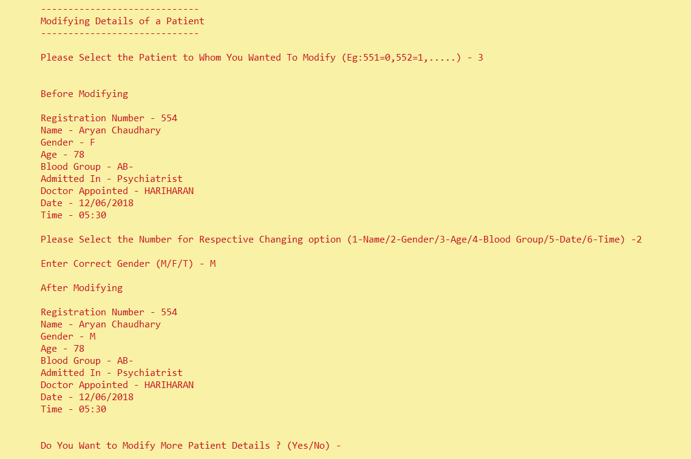
Result & Explanation
Now by selecting the modifying part by selecting number like
Name
Gender
Age
Blood Group
Date
Time
Then you can modify that entry and save as it will display all the details after modifying

Slide 44
Result & Explanation
Now again it will ask whether we want to enter more entry

Slide 45
Result & Explanation
Listing Entry in Patient System

Slide 46
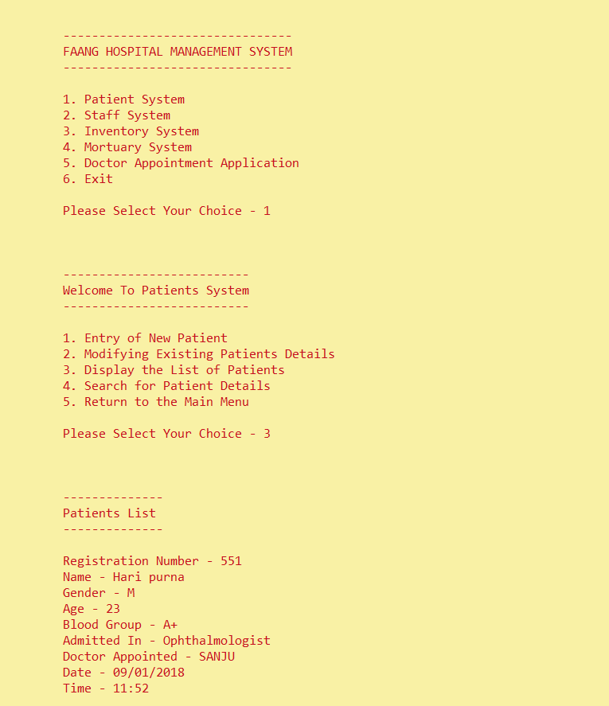
Result & Explanation
By selecting 3,
system will open list entered system for patient
So on

Slide 47
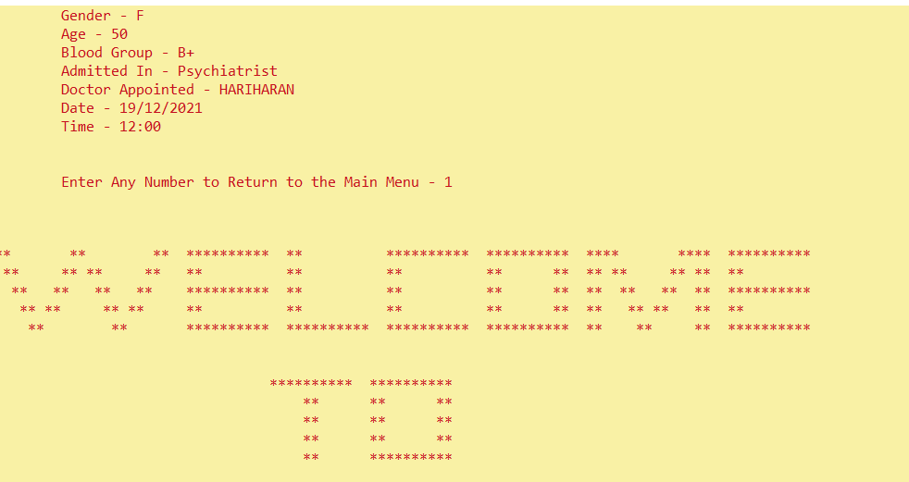
Result & Explanation
When you see all the details from the list,
It will ask you to enter any number that will send you to main menu

Slide 48
Result & Explanation
Search Entry in Patient System

Slide 49
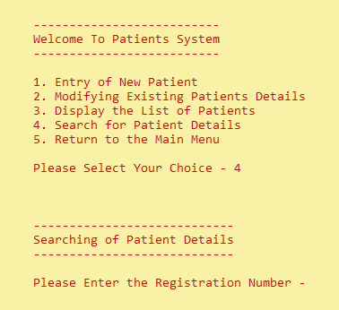
Result & Explanation
By selecting 4,
system will open search system for patient

Slide 50
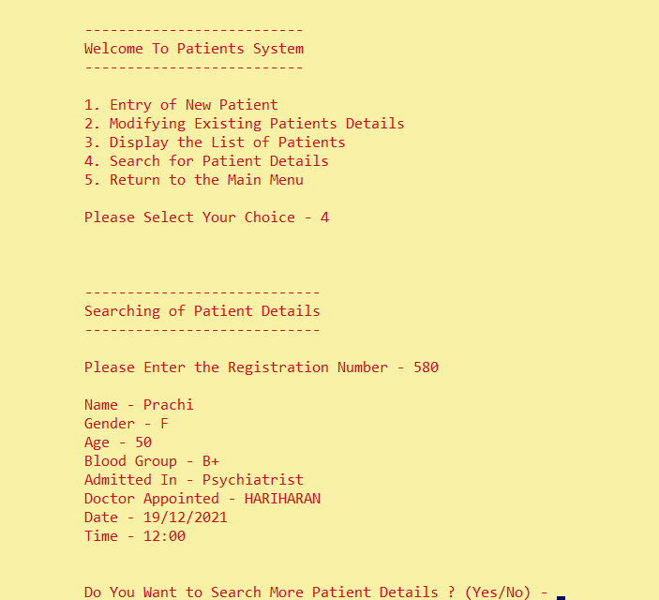
Result & Explanation
Just by entering the registration number, system will automatically show all the details of that patient

Slide 51
Result & Explanation
Now again it will ask whether we want to enter more entry

Slide 52
Result & Explanation
Return to main menu from Patient System

Slide 53
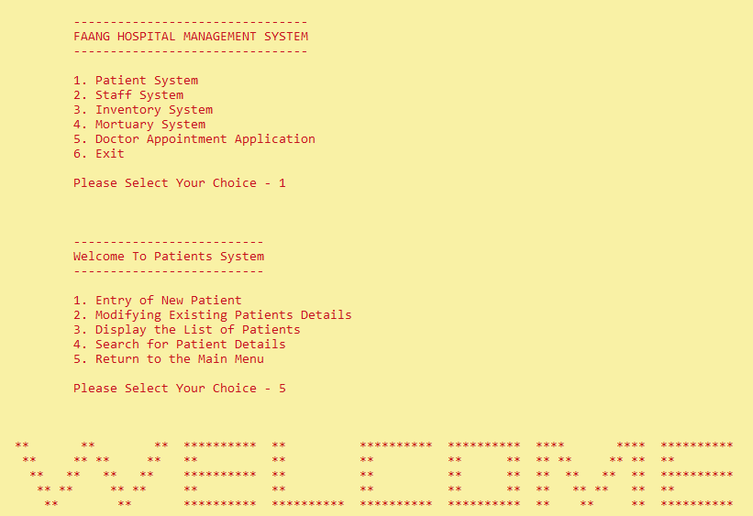
Result & Discussion
Result & Explanation
By selecting ,
system will return you to main menu from patient system

Slide 54
Result & Discussion
Result & Explanation
Staff System

Slide 55
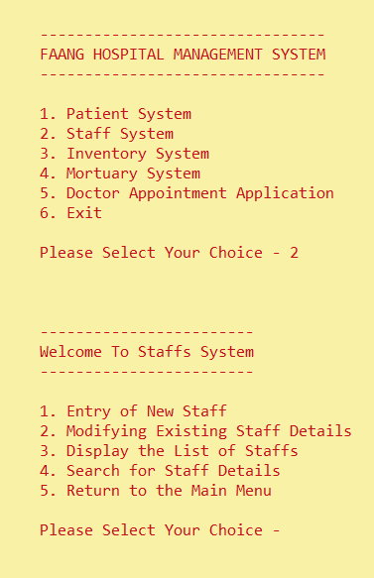
Result & Discussion
Result & Explanation
By selecting 2,
system will open staff system
Staff system is basically divided into 5 parts by using switch case :-
New Entry
Modify Entry
List Entry
Search Entry
Return to main menu
By select the serial number you will be on that page

Slide 56
Result & Discussion
Result & Explanation
New Entry in Staff List

Slide 57
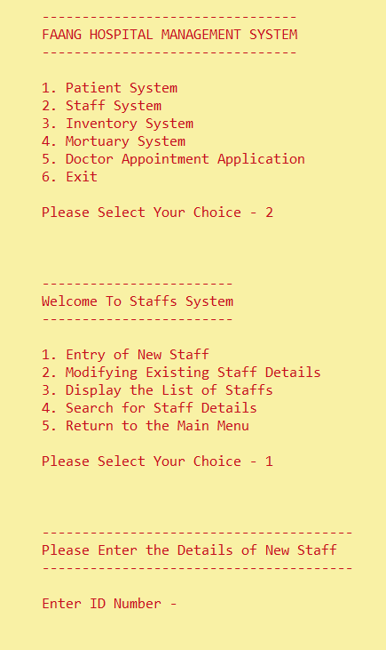
Result & Discussion
Result & Explanation
By selecting 1,
system will open new entry system for staff

Slide 58
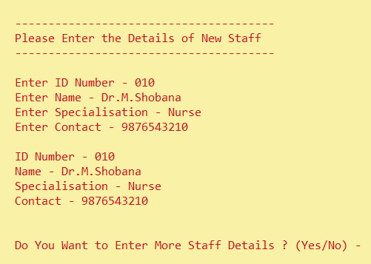
Result & Discussion
Result & Explanation
Just by enter data one by one, after last entry system will automatically display of that staff

Slide 59
Result & Discussion
Result & Explanation
Now again it will ask whether we want to enter more entry

Slide 60
Result & Discussion
Result & Explanation
Modify Entry in Staff System

Slide 61
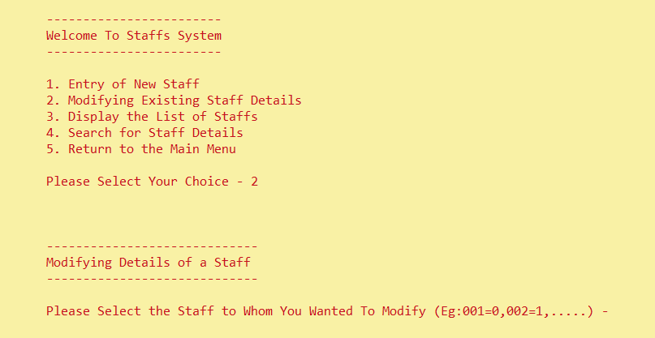
Result & Discussion
Result & Explanation
By selecting 2,
system will open modify entry system for staff

Slide 62
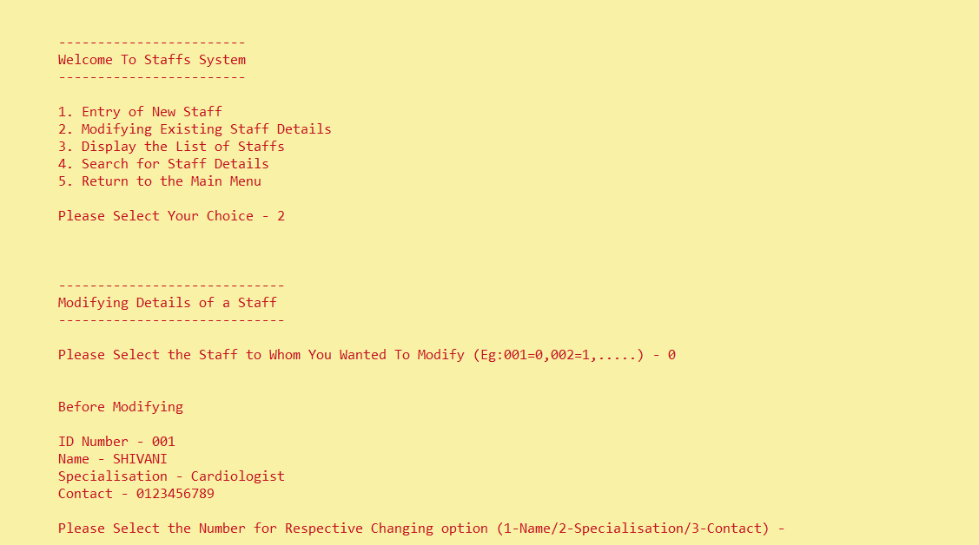
Result & Explanation
Result & Discussion
Just entering the index number of respective ID number, it will show complete details before modify

Slide 63
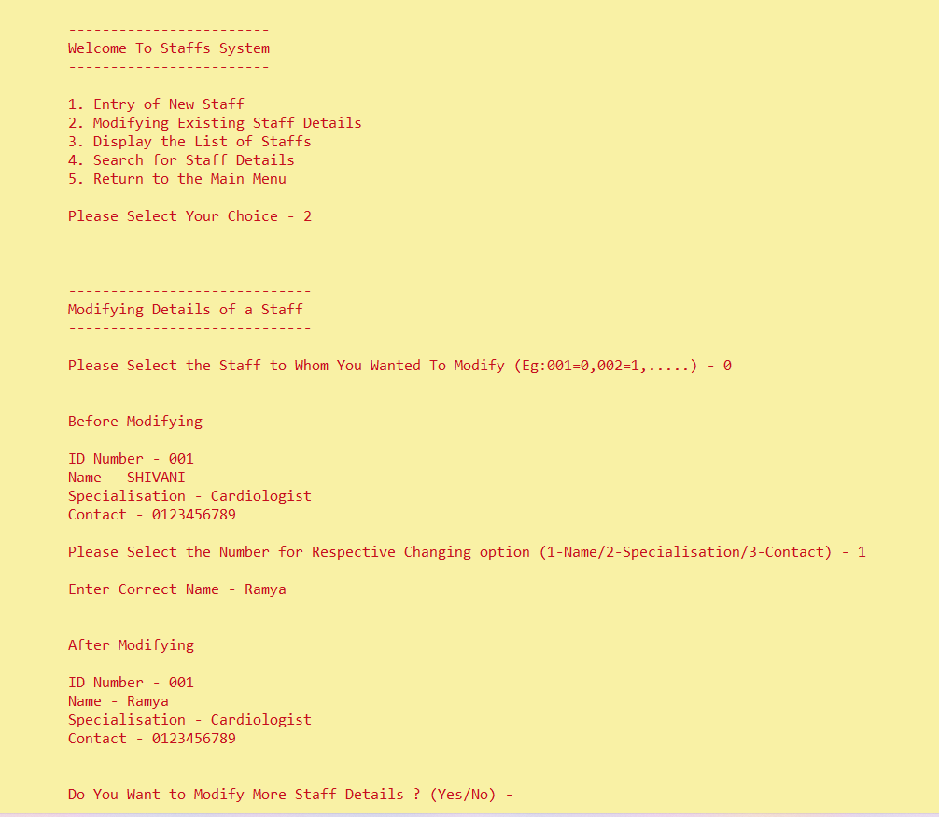
Result & Discussion
Result & Explanation
By selecting the number for which you want to correct and entering the new details
Just entering new enter system will show details after modify

Slide 64
Result & Discussion
Result & Explanation
Now again it will ask whether we want to enter more entry

Slide 65
Result & Discussion
Result & Explanation
Listing Entry in Staff System

Slide 66
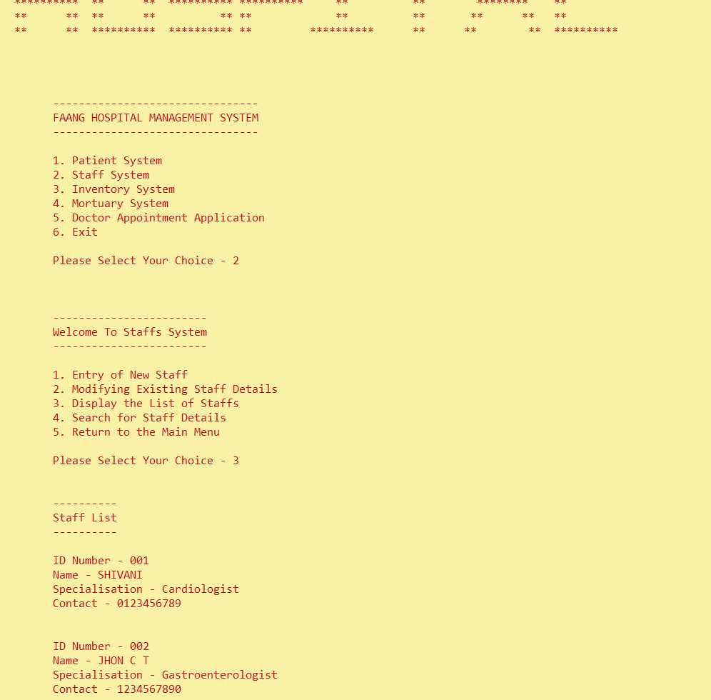
Result & Explanation
Result & Discussion
By selecting 3,
system will open list entered system for staff

Slide 67
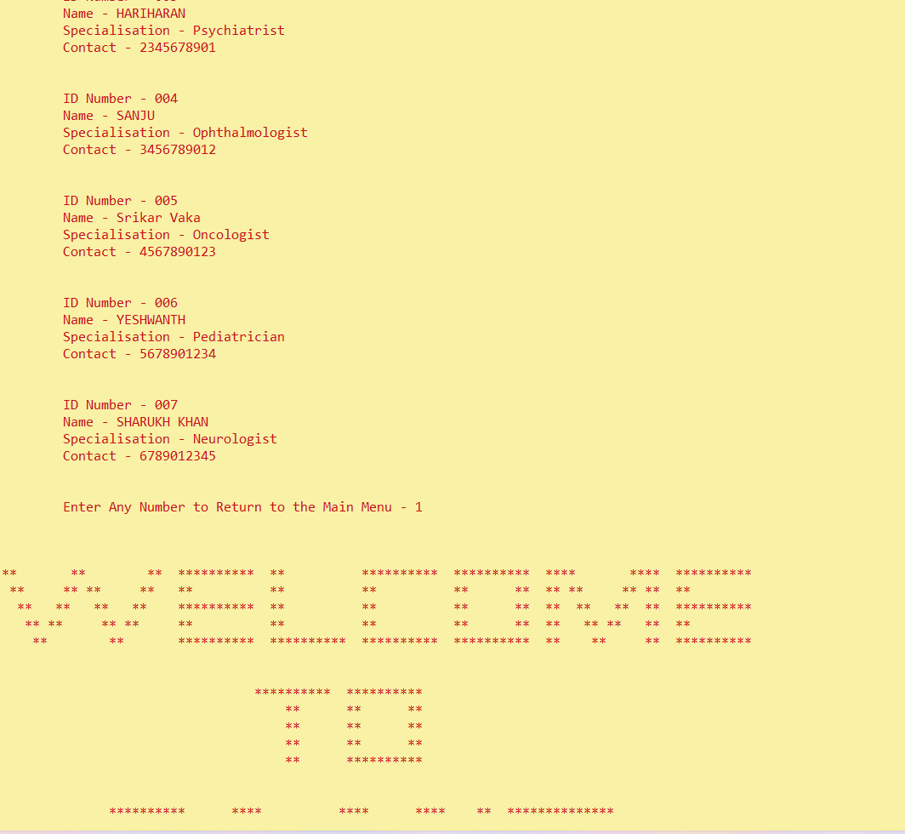
Result & Discussion
Result & Explanation
When you see all the details from the list,
It will ask you to enter any number that will send you to main menu

Slide 68
Result & Discussion
Result & Explanation
Search Entry in Staff System

Slide 69
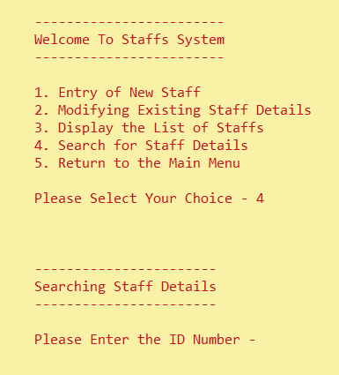
Result & Discussion
Result & Explanation
By selecting 4,
system will open search system for staff

Slide 70
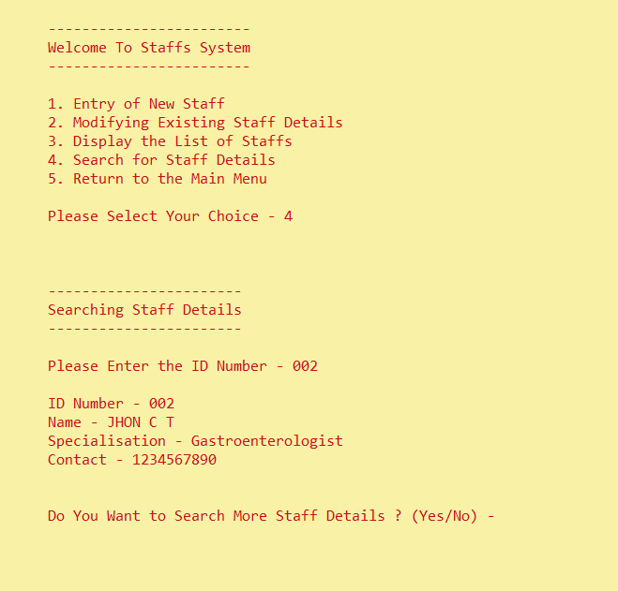
Result & Discussion
Result & Explanation
Just by entering the ID number, system will automatically show all the details of that staff

Slide 71
Result & Discussion
Result & Explanation
Now again it will ask whether we want to enter more entry

Slide 72
Result & Discussion
Result & Explanation
Return to main menu from Staff System

Slide 73
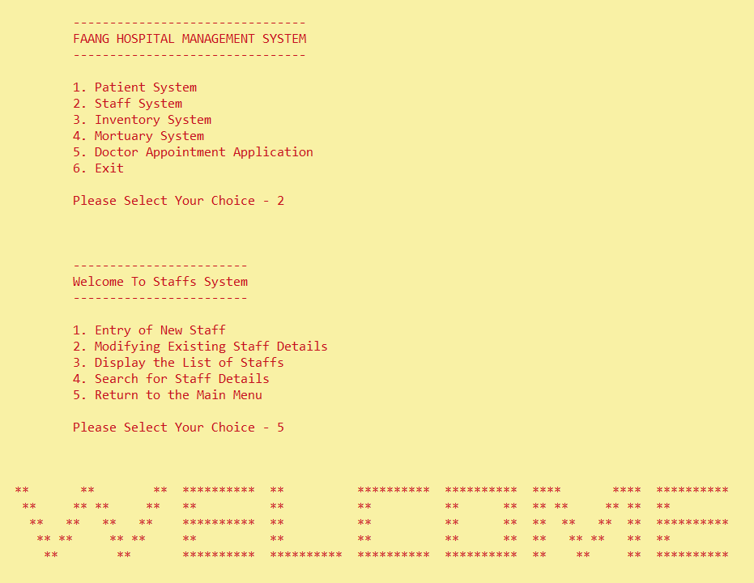
Result & Discussion
Result & Explanation
By selecting ,
system will return you to main menu from patient system

Slide 74
Result & Discussion
Result & Explanation
Result & Discussion
Inventory System

Slide 75
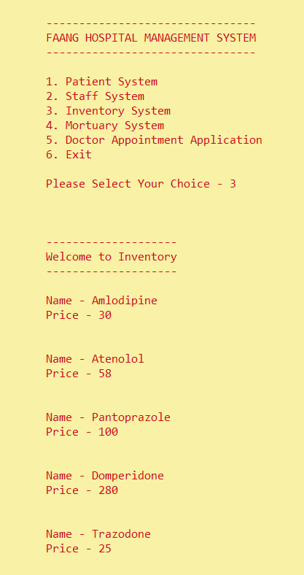
Result & Explanation
Result & Discussion
By selecting 2,
system will open staff system
It will display all the medicine name and price

Slide 76
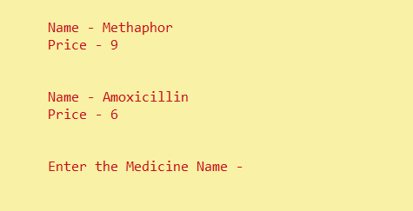
Result & Discussion
Result & Explanation
Now you must enter medicine name from above list

Slide 77
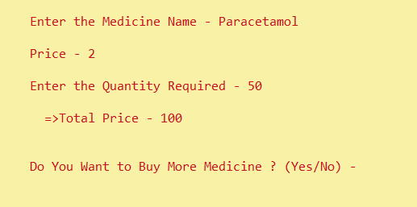
Result & Discussion
Result & Explanation
Just after entering the name, it will show the medicine price
Now it will ask for quantity required, just after that it will show the total price

Slide 78
Result & Discussion
Result & Explanation
Now system will ask whether you want to add more medicine

Slide 79
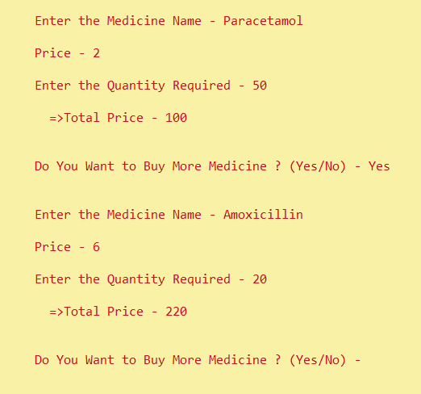
Result & Discussion
Result & Explanation
If yes for more medicine, you must enter more medicine name and price
Total sum will be added of all the medicine

Slide 80
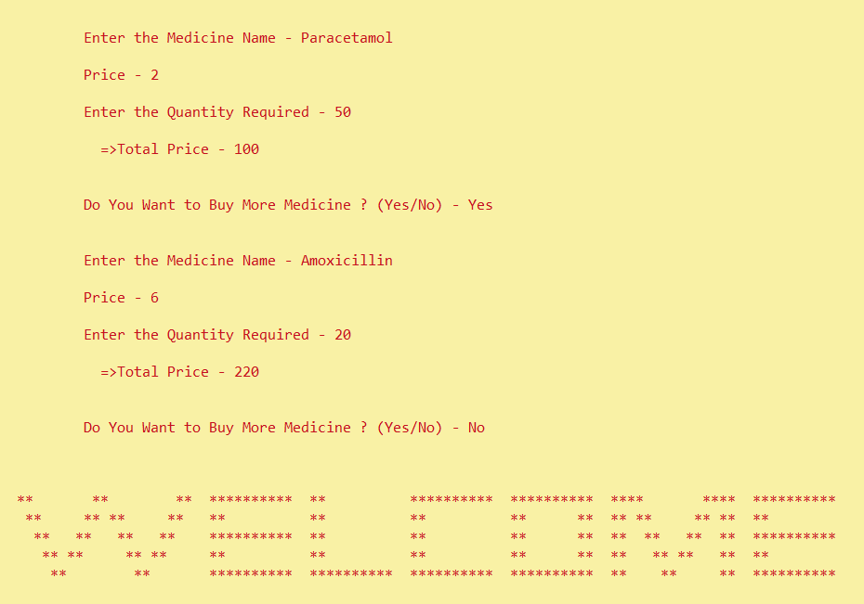
Result & Discussion
Result & Explanation
If no, then you will be return to the main menu

Slide 81
Result & Discussion
Result & Explanation
Mortuary System

Slide 82
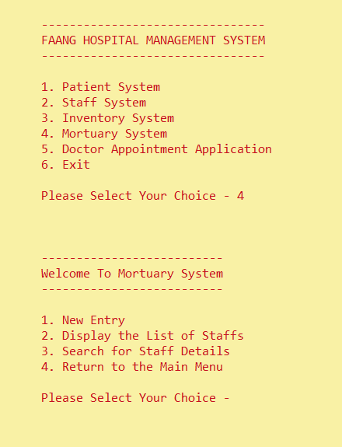
Result & Discussion
Result & Explanation
By selecting 4,
system will open mortuary system
mortuary system is basically divided into 4 parts by using switch case :-
New Entry
List Entry
Search Entry
Return to main menu
By select the serial number you will be on that page

Slide 83
Result & Discussion
Result & Explanation
Mortuary System
New Entry in Mortuary List

Slide 84
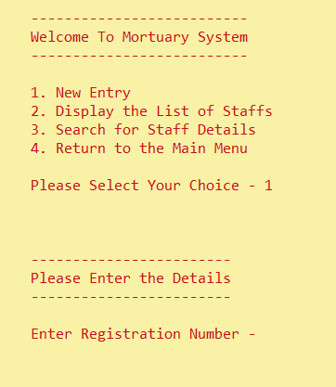
Result & Explanation
Result & Explanation
By selecting 1,
system will open new entry system for mortuary

Slide 85
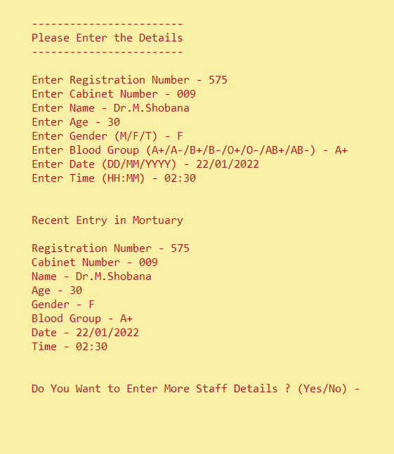
Result & Explanation
Just by enter data one by one, after last entry system will automatically display details

Slide 86
Result & Explanation
Result & Explanation
Now again it will ask whether we want to enter more entry

Slide 87
Result & Explanation
Listing Entry in Mortuary System
Display in Mortuary List

Slide 88
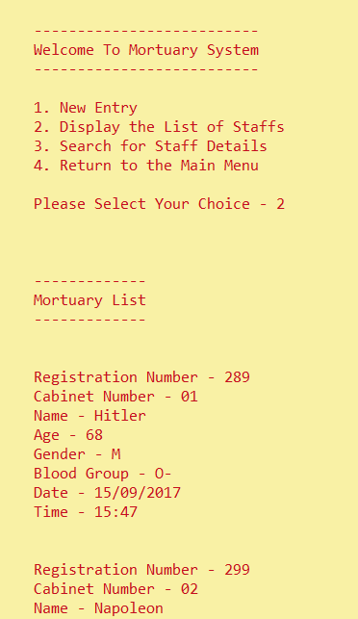
Result & Explanation
By selecting 2,
system will open list entered system for mortuary

Slide 89
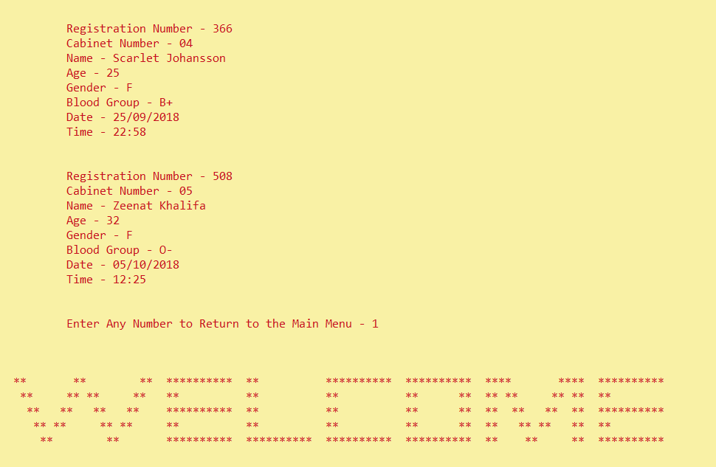
Result & Explanation
Result & Explanation
When you see all the details from the list,
It will ask you to enter any number that will send you to main menu

Slide 90
Result & Explanation
Search Entry in Mortuary System

Slide 91
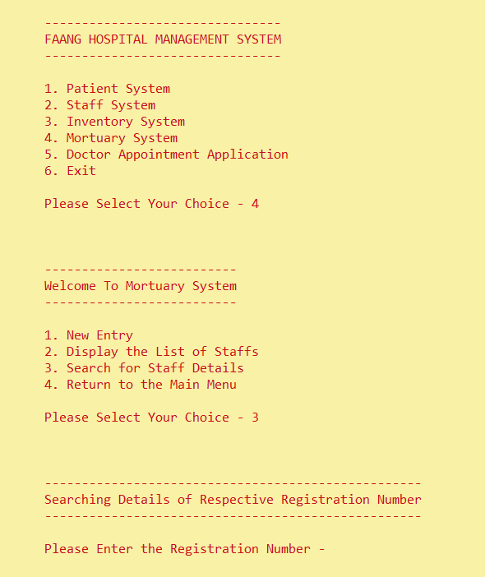
Result & Explanation
By selecting 3,
system will open search system for mortuary

Slide 92
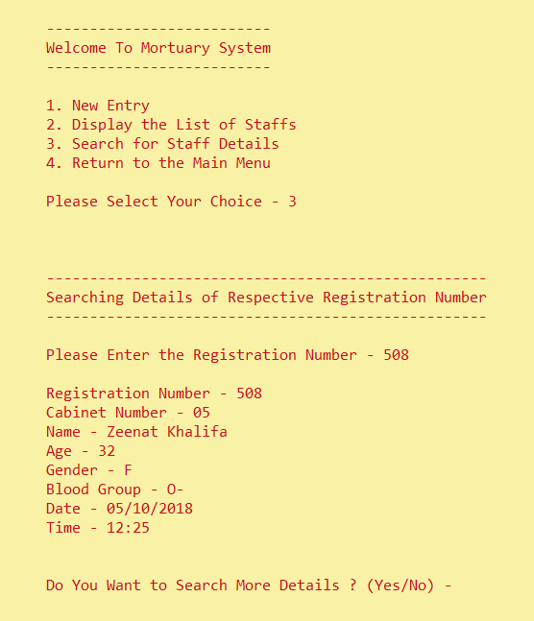
Result & Explanation
Just by entering the registration number, system will automatically show all the details

Slide 93
Result & Explanation
Result & Explanation
Now again it will ask whether we want to enter more entry

Slide 94
Result & Discussion
Result & Explanation
Return to main menu from Mortuary System

Slide 95
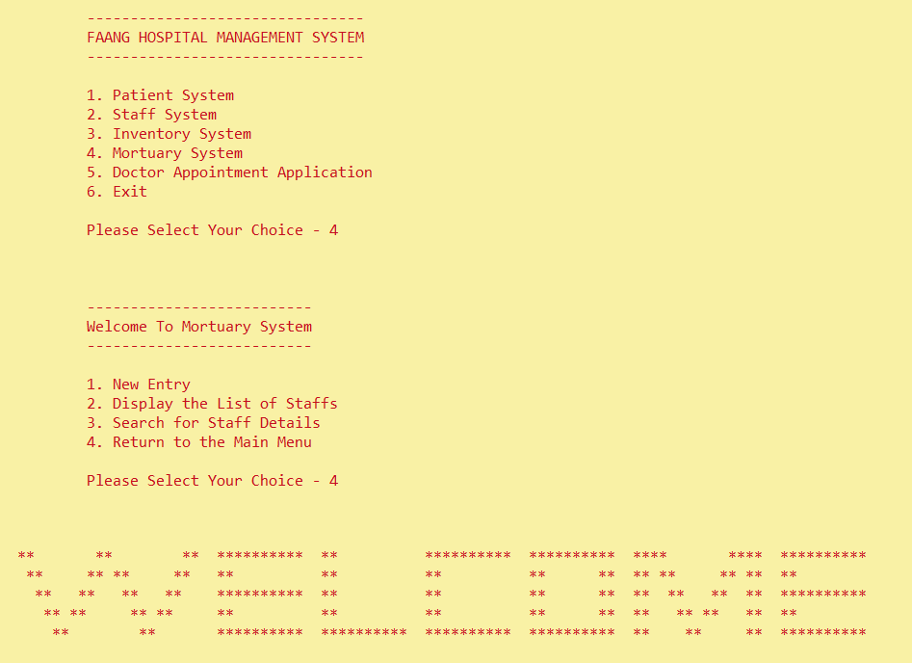
Result & Explanation
Result & Explanation
By selecting ,
system will return you to main menu from patient system

Slide 96
Result & Explanation
Doctor Appointment Application

Slide 97
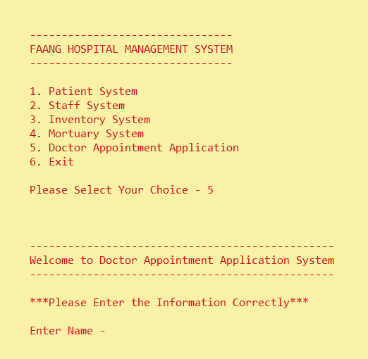
Result & Explanation
By selecting 5,
system will open doctor appointment application system

Slide 98
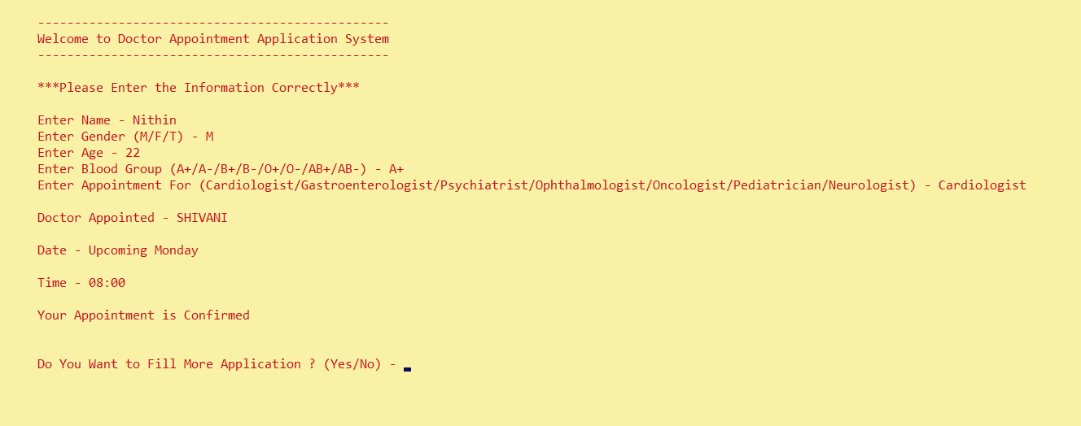
Result & Explanation
By enter the details, system will automatically display the doctor appointed, date, time

Slide 99
Result & Explanation
Now again it will ask whether we want to enter more entry

Slide 100
Result & Explanation
Result & Explanation
End the Program

Slide 101
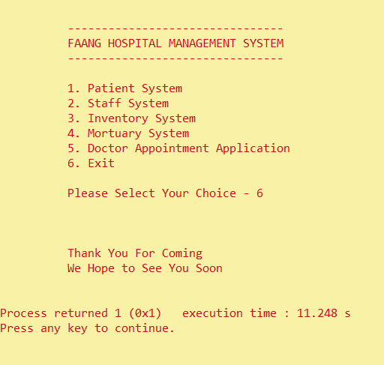
Result & Explanation
Result & Explanation
By selecting 6,
system will exit the program by giving a sweet note

Slide 102
Thanks

